Slide 1
Proteins: theory and preparation for simulation
PHRMSCI 275. Drug Discovery Computing Techniques
The University of California, Irvine
02/29/2022
Mary Pitman, PhD, contact: mpitman@uci.edu

Slide 2

Outline
Background: why the starting configuration can make or break your simulation
Theoretical considerations: statistical mechanics, protein physics
Limitations of atomic resolution simulations
Structure files
Protein Data Bank: crystallography, NMR, cryo-EM, AlphaFold
Tools and considerations.
Scan to access pptx and follow along, get links

Slide 3
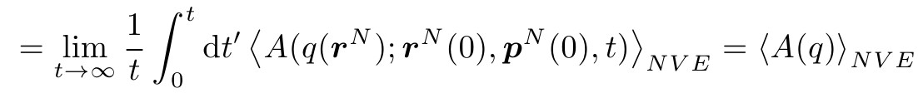
Statistical Mechanics Postulate
Ergodic Hypothesis: The (long) time average of any mechanical property in a real macroscopic system is equal to the average value of that property over all microscopic states of the system. Each state is weighted by the probability of occurrence, provided that the microscopic sates replicate the thermodynamic state and environment of the actual system.
If the ergodic hypothesis is true, then time averages equal ensemble averages (Ehrenfests 1912).
Further reading: (1) Compendium of the Foundations of Classical Statistical Physics, Jos Uffink
(2) An Introduction to Applied Statistical Thermodynamics, Sandler, Section 1.4

Slide 4
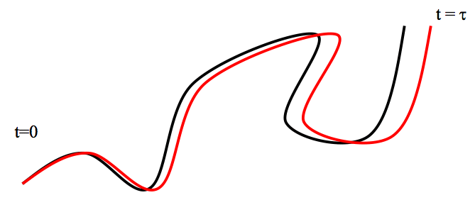
Starting conditions can have unpredictable trajectory effects
The dynamics of a well ­behaved, classical, many ­body system is chaotic.
∴ Trajectories that differ in their initial conditions diverge exponentially (“Lyapunov stability”)
… but we can obtain meaningful thermodynamic quantities from MD
due to the “shadow therom”
Further reading: Statistical Mechanics and Molecular Dynamics, Luca M. Ghiringhelli, link
Notes:
Lyapunov stability: https://www.youtube.com/watch?v=kVq3mHSliZE

Slide 5
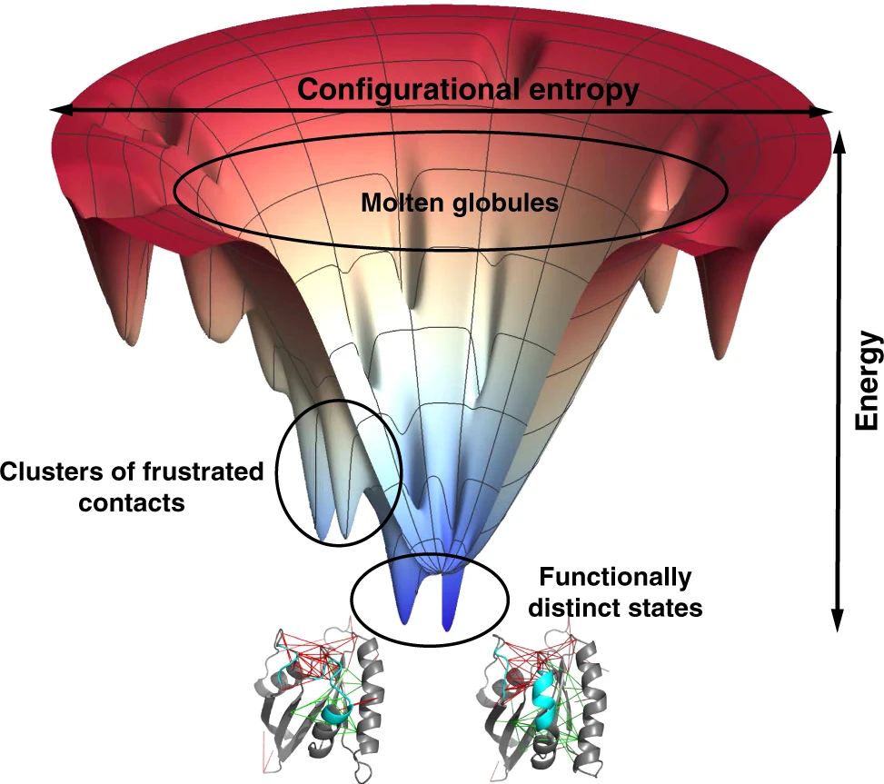
Starting conditions can have unpredictable trajectory effects
The physics of proteins is ‘glassy’ and so overall the assumption of ergodicity does not hold.
Protein folding trajectory
Coevolutionary information…and the thermodynamics of natural selection, Morcos et al.
Funnels, Pathways, and the Energy Landscape of Protein Folding: A Synthesis, Bryngelson et al.

Slide 6
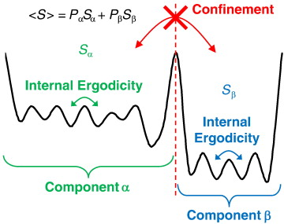
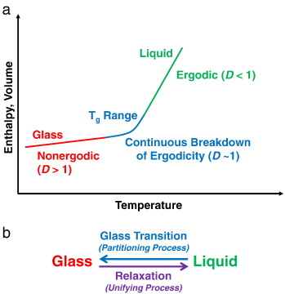
Starting conditions can have unpredictable trajectory effects
Proteins undergo a glass transition as they fold
The free energy landscape is rugged, or frustrated. As the protein folds it becomes trapped in local minima.
Within these minima, there is pseudo-ergodicity (Ehrenfests)
(1) Statistical mechanics of glass, Mauroa & Smedskjaer paper link

Slide 7
A minima does not mean “native”. The crystal structure may not be ”native”.
Proteins undergo a glass transition as they fold
The free energy landscape is rugged, or frustrated. As the protein folds it becomes trapped in local minima.
Within these minima, there is pseudo-ergodicity (Ehrenfests)
(1) Statistical mechanics of glass, Mauroa, Smedskjaer paper link

Slide 8
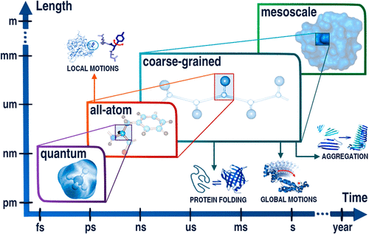
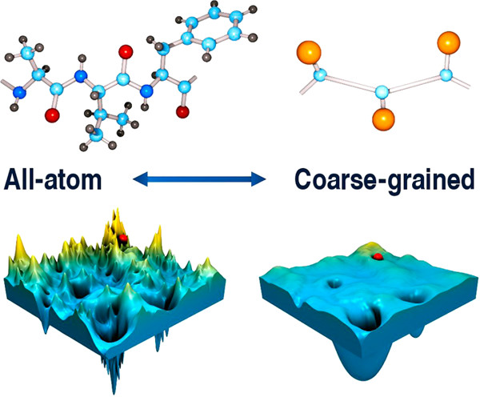
In all-atom MD, the phase space sampled will be limited.
Mistakes in the starting configuration are unlikely to be resolved.
(1) Coarse-Grained Protein Models and Their Applications, Kmiecik et al.

Slide 9
Outline
Background: why the starting configuration can make or break your simulation
Theoretical considerations: statistical mechanics, protein physics
Limitations of atomic resolution simulations
Structure files
Protein Data Bank: crystallography, NMR, cryo-EM, , AlphaFold
Tools and considerations

Slide 10
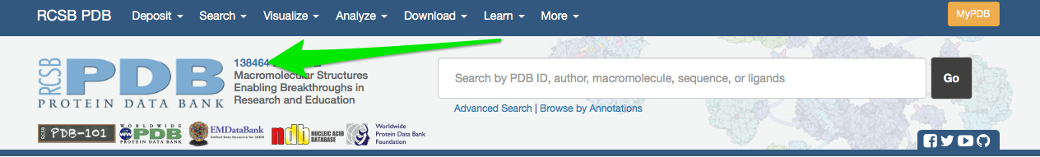
The Protein Data Bank (PDB) is a repository which stores structures of macromolecules
www.rcsb.org

Slide 11
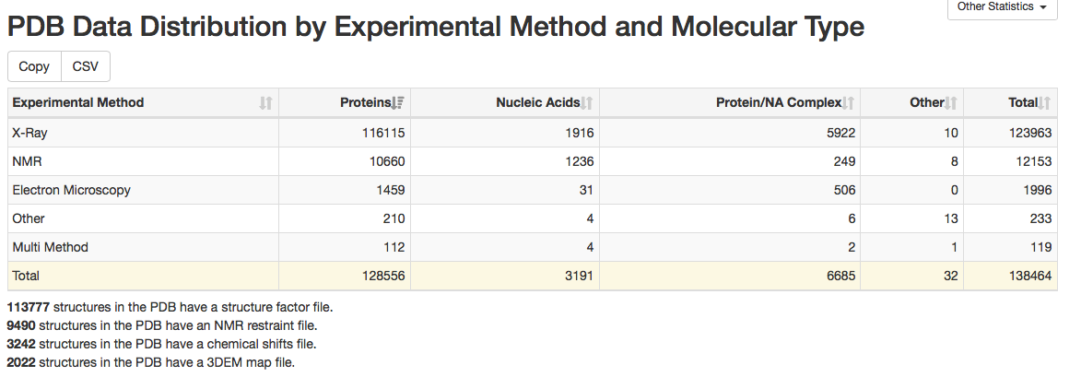
Most structures are obtained via crystallography
(RCSB PDB)
Notes:
Note most x-ray structures obtained at cryo temperatures
Starting to be some work at obtaining these at physiological temperatures. Looks like some remarkable differences in some cases

Slide 12
What’s in a PDB file?
Coordinates:
Atom list
3D position in space
“occupancy”
Missing information!
Experimental details
What the system is, how the structure was solved, secondary structure information, protein sequence
Other info:
i.e. citations

Slide 13
Crystallography tries to turn diffraction data into structures
Really, there is not quite enough data -- each atom has about 3-4 parameters, and we have about one observation per parameter
This means we fit a model to the data
http://www-structmed.cimr.cam.ac.uk/Course/Overview/Overview.html

Slide 14
PDB files for crystals contain just a portion of the whole crystal structure -- the “asymmetric unit”
(Source: PDB)
(Source: PDB)
Notes:
Asymmetric unit: Unique part of the structure, can be used to build the entire crystal structure after application of symmetry operations

Slide 15
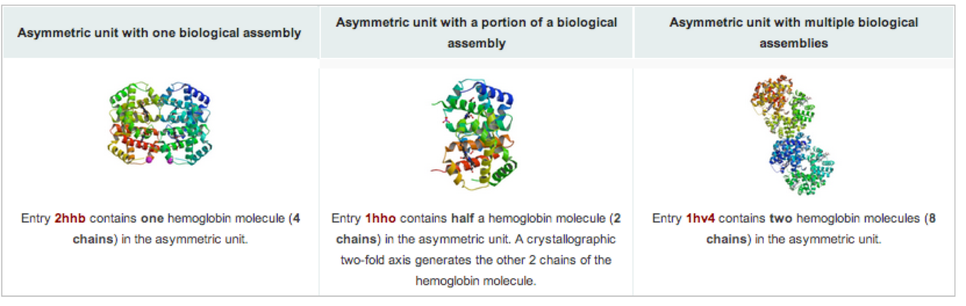
The biological assembly may or may not be the same as the asymmetric unit
Asymmetric unit can be:
A single biological assembly
Multiple biological assemblies
Part of a biological assembly
(Source: PDB)

Slide 16
But at some point, we have to fit a model to the "data" -- the electron density
It is nonobvious where the atoms should be -- and this is good data
Notes:
http://www-structmed.cimr.cam.ac.uk/Course/Basic_refinement/Refinement.html

Slide 17
The actual model IS consistent with this data, but the model is not the data. So we should visualize the maps to verify consistency
Notes:
http://www-structmed.cimr.cam.ac.uk/Course/Basic_refinement/Refinement.html

Slide 18
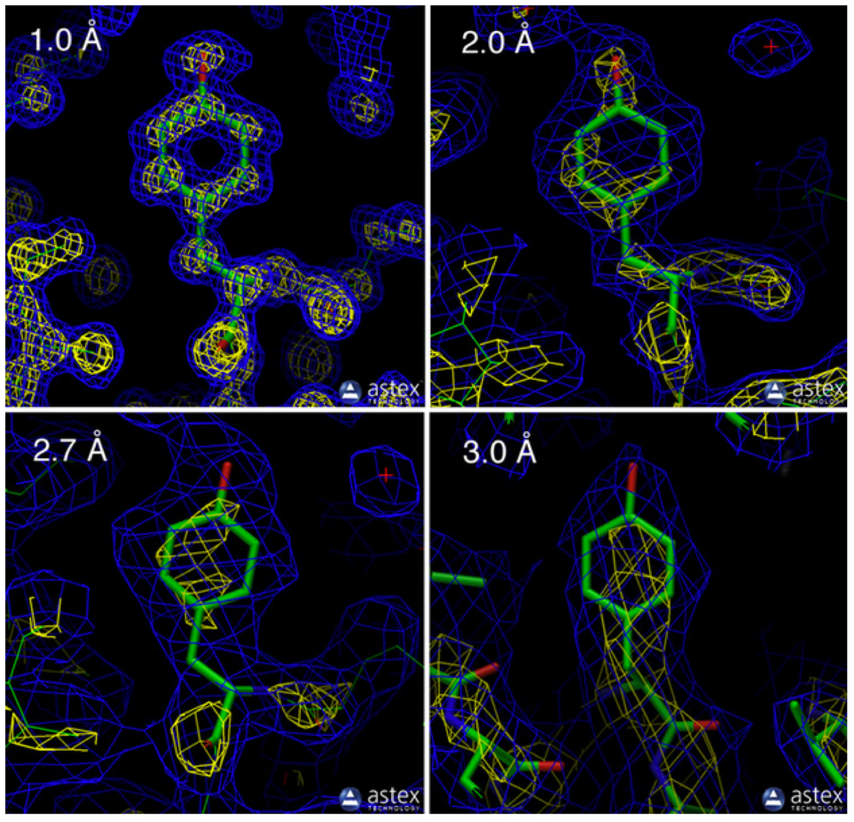
Resolution is an important aspect when looking at structures
(Source: PDB)
Notes:
High resolution: Electron density really reveals where every atom is and what it is
Low resolution: Electron density suggests where trace is, actual atomic details must be inferred from a model

Slide 19
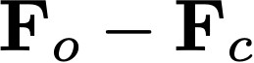
There are two common ways of visualizing the electron density
"Difference map"
Shows difference between calculated and observed structure factors
The map itself, usually as
Shows the actual observations, with the difference from the calculated values also appearing to a limited extent
Notes:
Observed structure factors -- with calculated phases

Slide 20
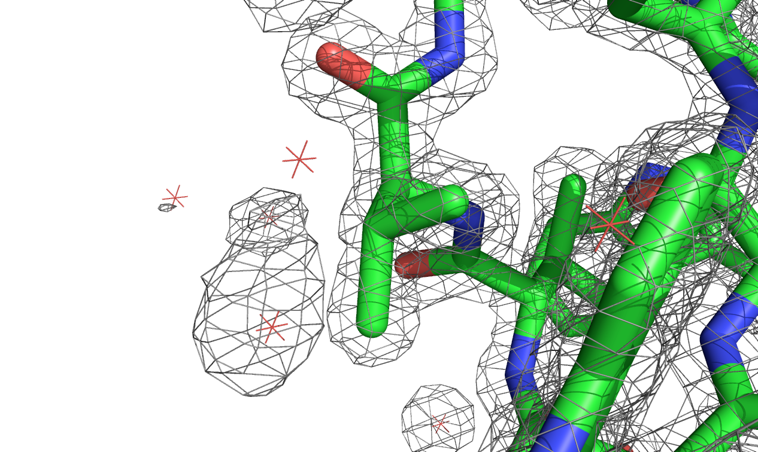
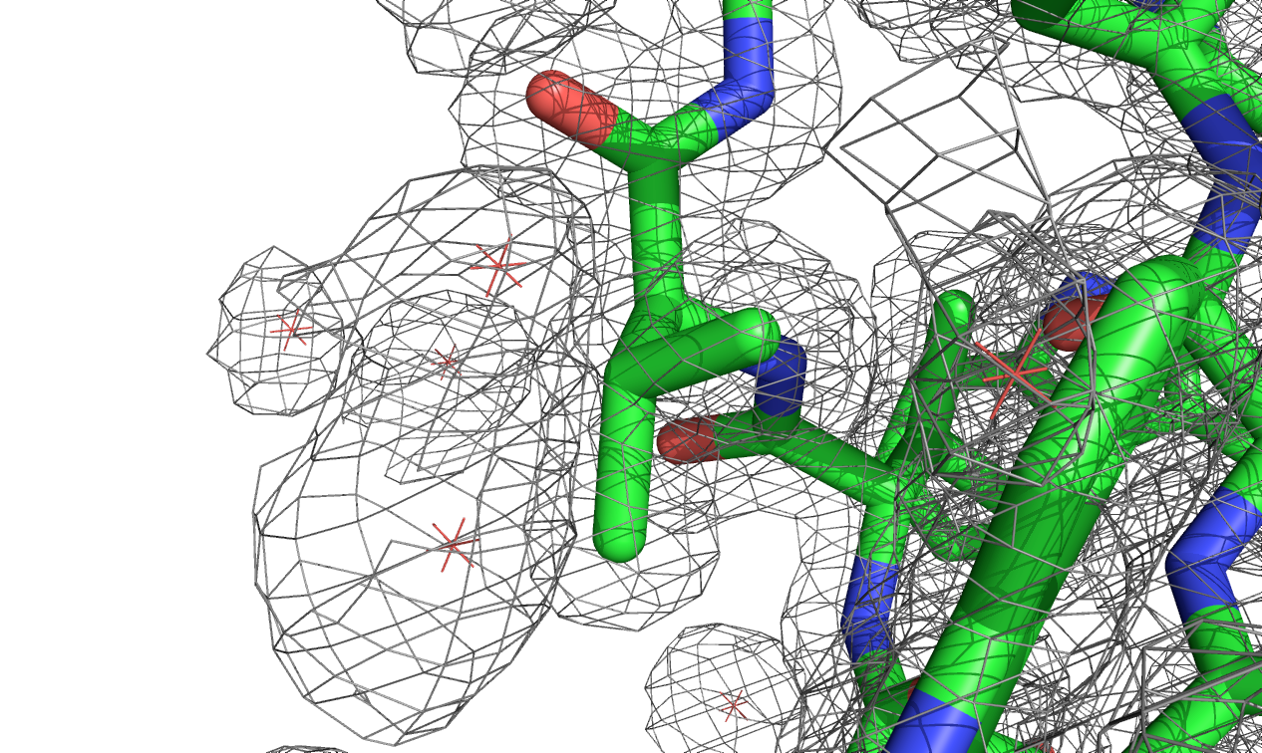
But, there is a value for the electron density everywhere, so we have to select contour levels
Notes:
2Fo-Fc maps, 1w2i structure. Map source: EDS
Left: 2 sigma, Right: 1 sigma
Sigma is the standard deviation of all density values. So, you're showing where the electron density is highest, etc., measured in units of the standard deviation in the electron density.

Slide 21
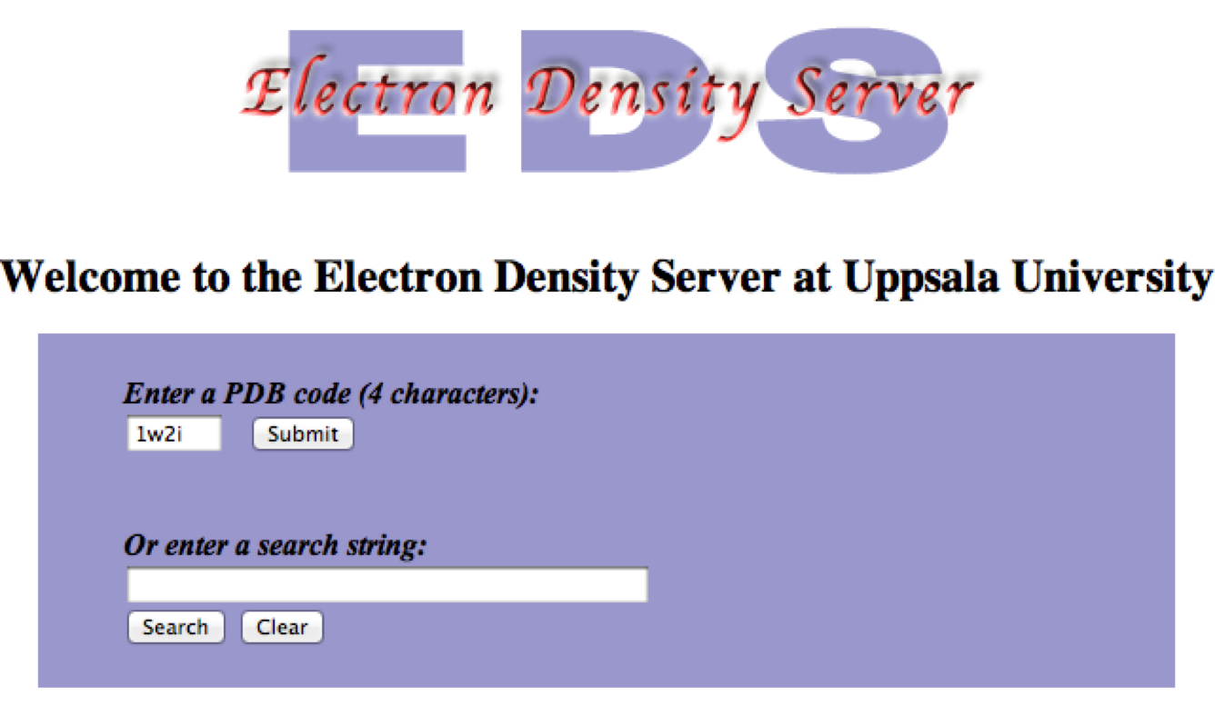
PDB files don't actually contain electron density, though modern ones contain calculated structure factors
Calculated structure factors yield the electron density
Usually, see the Electron Density Server to get electron densities
http://eds.bmc.uu.se/eds/

Slide 22
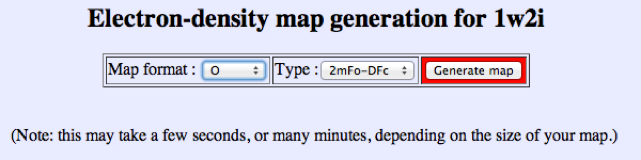
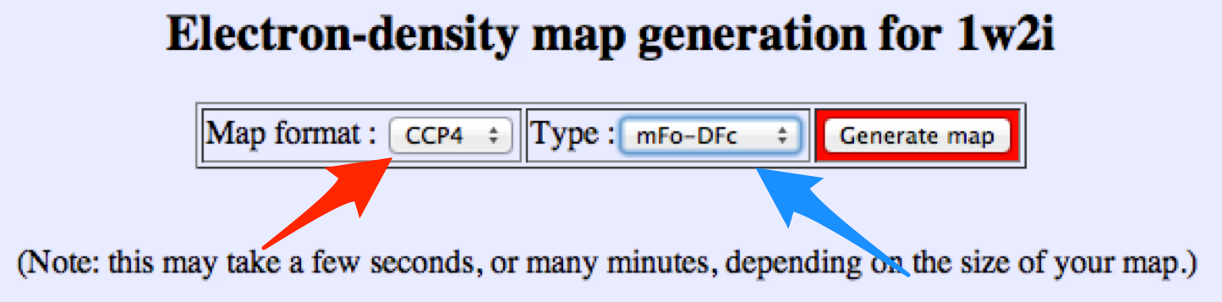
From EDS, you choose a type of map and a format
Let's do a difference map for visualization in PyMol
Notes:
PyMol handles CCP4 format
the 2mFo-DFc is 2Fo-Fc; mFo - DFc is Fo-Fc. So here we're choosing a difference map

Slide 23
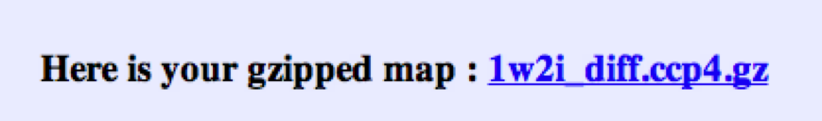
Next, I download the map to my computer, extract it, and get ready to load into PyMol
Check out this PyMol tutorial:
http://pymolwiki.org/index.php/Display_CCP4_Maps
Note: Difference maps usually contoured at +/- 2.5 sigma

Slide 24
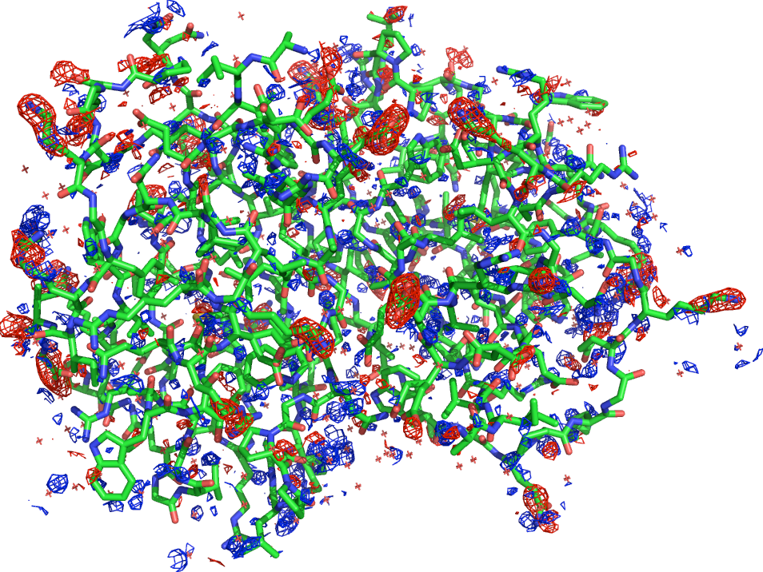
In PyMol:
load 1W2I.pdb
load 1w2i_diff.ccp4, 1W2I_map
load 1w2i.ccp4, 1W2I_2fo
isomesh map_pos, 1W2I_map, 2.5, 1W2I, carve = 1.6
isomesh map_neg, 1W2I_map, -2.5, 1W2I, carve = 1.6
isomesh map, 1W2I_2fo, 1.0, 1W2I, carve = 1.6
color gray, map
color blue, map_pos
color red, map_neg
show sticks

Slide 25
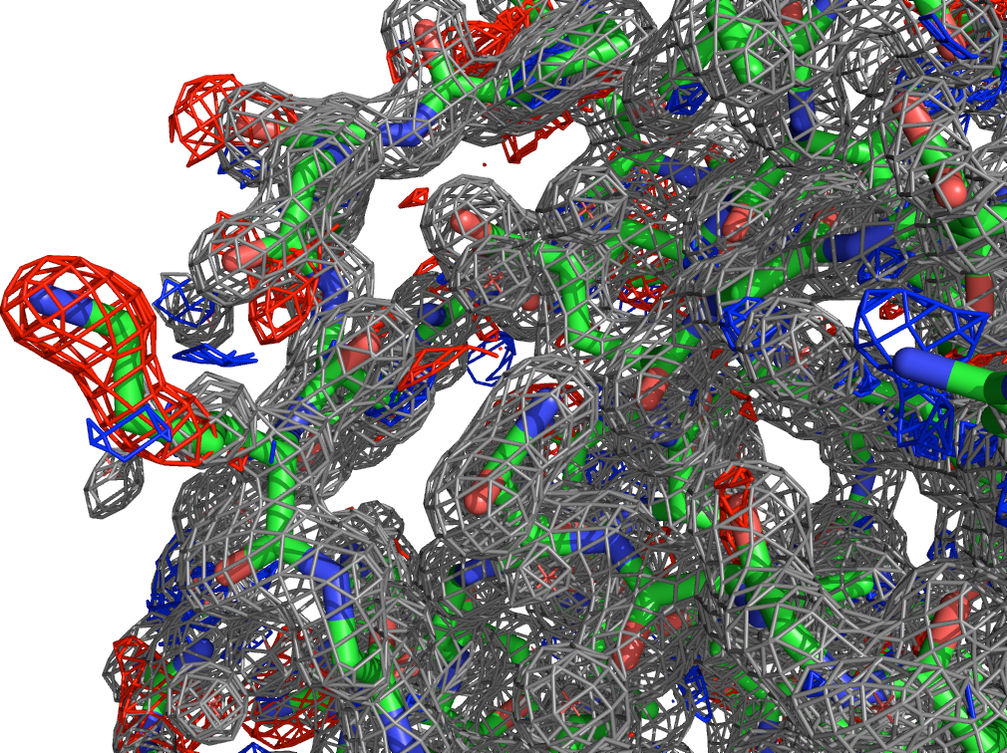
Let's focus on an area with large differences and look at the actual density there as well
The data: The diffraction pattern
The results: The electron density
The author's interpretation: The structure
Notes:
Ah, missing density for solvent exposed residue...

Slide 26
R-value and R-free are important factors in reliability
R value: Measures how well simulated diffraction pattern matches experiment
Ideal: R=0
Typical: R~0.2
Random: R about 0.63
But R value is used in building model, which introduces bias
Better: Use R-free
R value on 10% of data which is held back and not used in building model. Typically slightly higher, around 0.26
Big concern if it is ever a lot higher than R -- suggests overfitting
(Source: PDB)

Slide 27
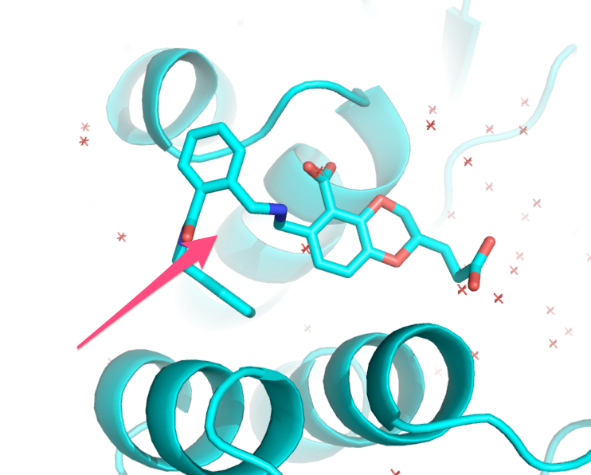
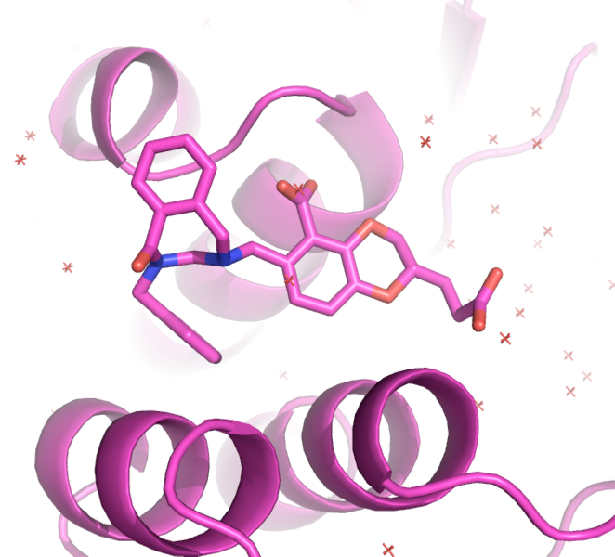
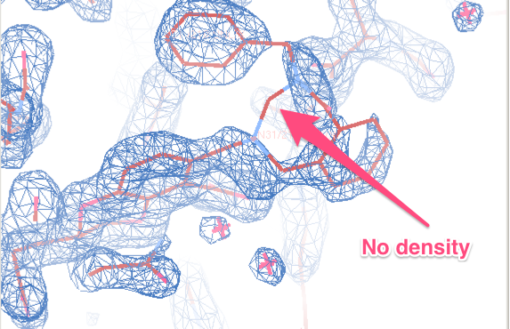
A lot of other things can get in the way: How sure are you of what you’re looking at?
Notes:
SAMPL4 HIV integrase inhibitors from CSIRO/Avexa, AVX38741
In deposition to the PDB, they noticed there was very weak density for the bridged larger ring in this system. Upon reassessment of the chemistry, they realized there was actually a chance they might have a different compound... Which, as it turns out, fits the density better.

Slide 28
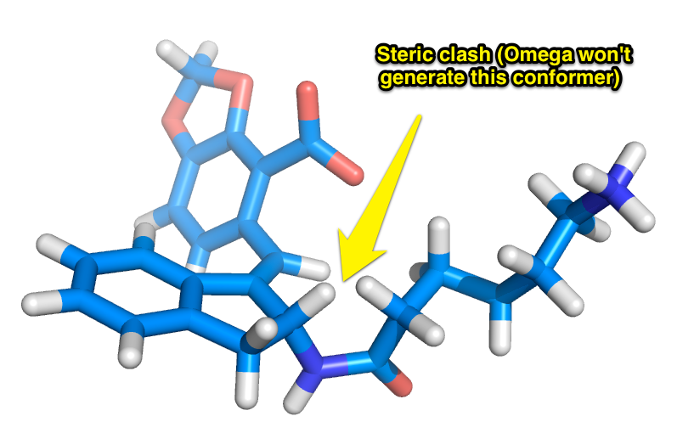
Molecular modeling is used in refinement. Do you have the right balance of forces and density?
Notes:
AVX101124 -- initial refinement had ligand placed this way, clash between two hydrogens at distance of 1.1 angstroms. Hadn’t been noticed since crystallographers often refine without hydrogens (since not resolved).

Slide 29
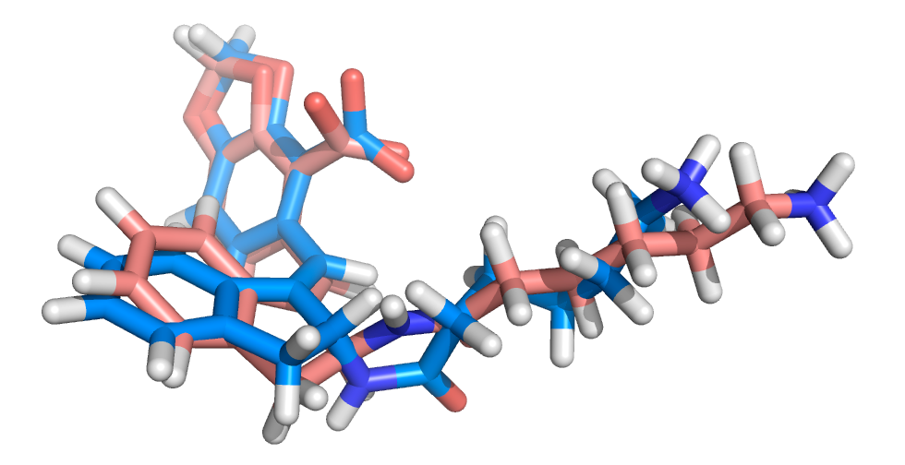
We proposed the opposite stereoisomer, which would eliminate the steric clash
Notes:
AVX101124 -- blue is original, orange is proposal
They were testing a mixture of stereoisomers, so if the alternate one fits the density as well or better (and eliminates the steric problem) it’s probably the one binding.

Slide 30
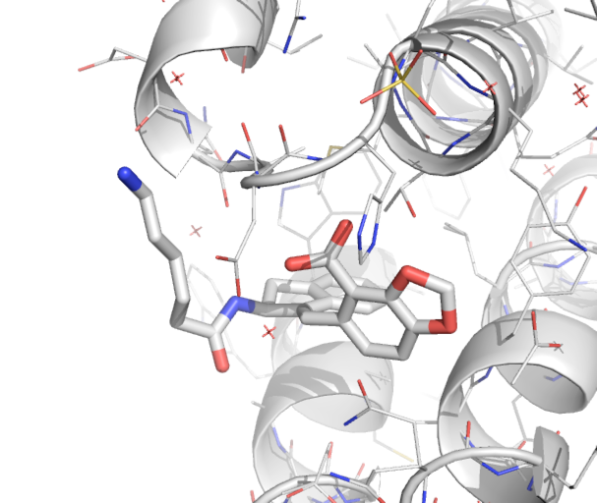
The newly refined model eliminates the steric clash

Slide 31
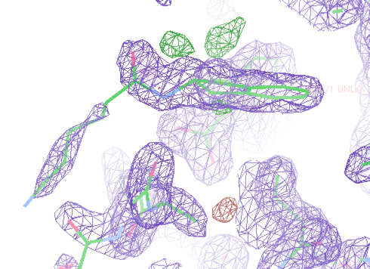
And it fits the density as well as the original model

Slide 32
Crystal structures are limiting in some respects
Proteins are not really static
They are a model fit to the data (the data is the diffraction pattern/electron density)
It’s easy to confuse them with the data itself
Bad modeling yields a bad model!
Hetero atoms are particularly problematic (i.e. ligands)
Crystal conditions, cosolvents, temperature can be important

Slide 33
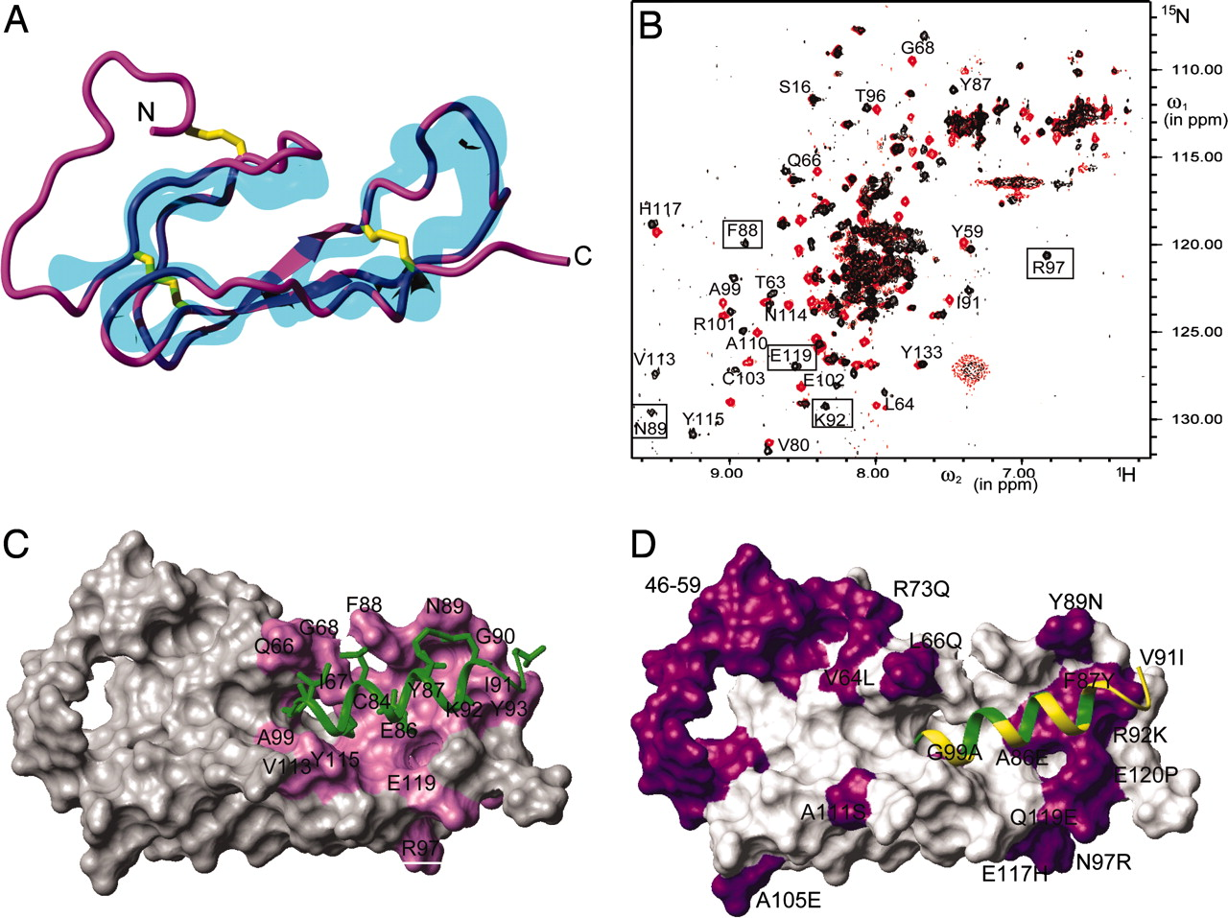
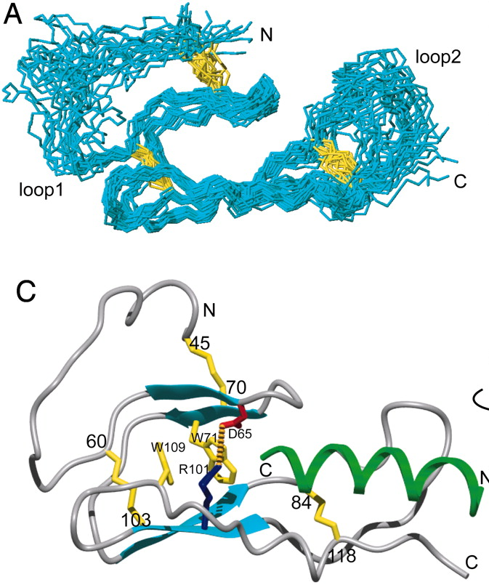
NMR structures are also deposited on the PDB
Proteins are not static and these structures are resolved in solution. Uses isotope labels.
So, the model includes multiple conformations.
NMR data can illuminate more than just structures, but it is size limited for what can be resolved.
(1) Grace et al. “Structure of the N-terminal domain …a peptide ligand" paper link

Slide 34
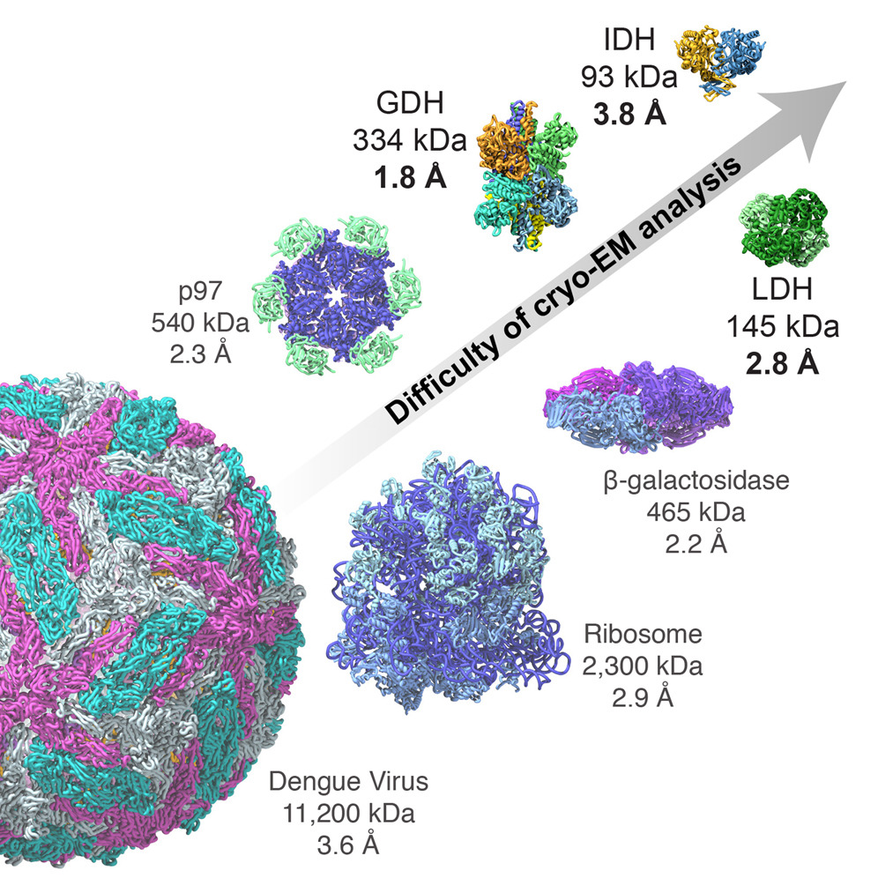
The next experimental revolution? Cryo-Electron Microscopy (cryo-EM)
Pros, for our purposes:
Rapid freezing and actual fixation in vitreous ice preserves the hydrated state. The structural information may better reflect the state of the sample before it was frozen.
Samples can be inhomogeneous allowing for observation of conformational ensembles.
The chemical environment can be controlled
Cons:
Potentially low resolution (but labs are working on applying ML to improving the signal to noise ratio detection)
Source: Merk et al.
Further reading: Revolutionary cryo-EM is taking over structural biology, Nature 578, 201 (2020)

Slide 35
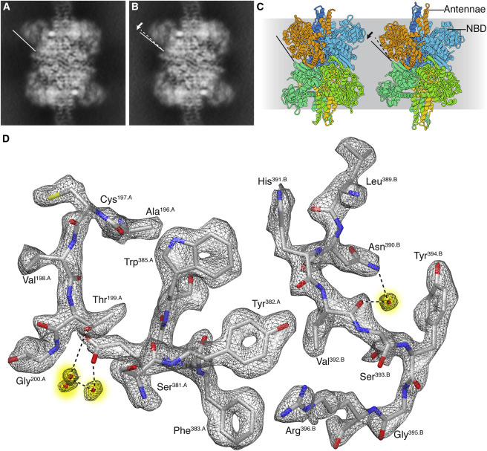
The next experimental revolution? Cryo-EM
Cryo-EM can now cross the 2 Å resolution barrier and resolve structures of proteins with sizes < 100 kDa.
This technique and applications of it will likely become rapidly more prevalent
Increasing applications in pharma for sm drug discovery and biologics
(1) Merk et al. “Breaking Cryo-EM …to Facilitate Drug Discovery” https://doi.org/10.1016/j.cell.2016.05.040

Slide 36
Homology modeling seeks to solve a common protein structure problem
We have a protein sequence of interest
ex. MET ALA ILE VAL ARG ALA HIS LEU LYS ILE TYR GLY ARG VAL GLN GLY VAL GLY PHE ARG TRP SER MET GLN ARG GLU ...
that is, MAIVRAHLKIYGRVQGVGFAWSMNRE...
We want to predict its structure
There are structures of related proteins available
How do we use the structures of these related proteins to help with our problem?
Notes:
AKA comparative modeling

Slide 37
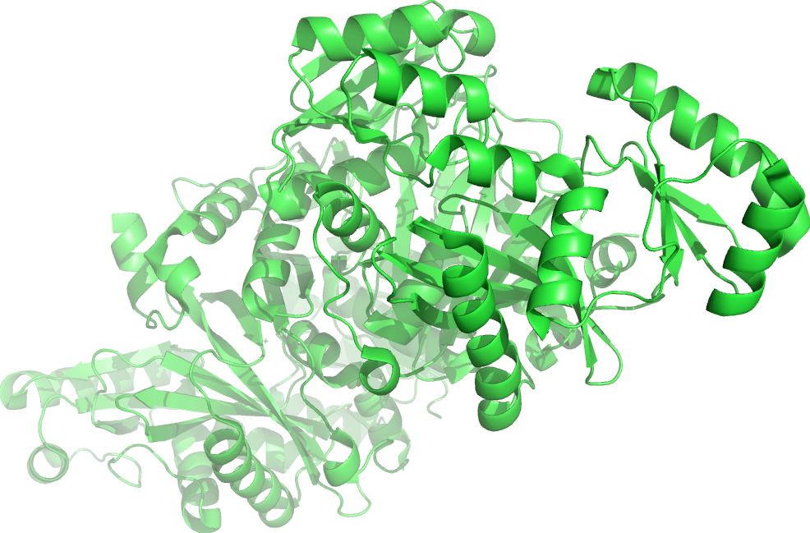
Homology or comparative models predict new structures based on knowns
Example: Could we predict the structure of BC in S. Aureus based on its structure in E. Coli?
MLDKIVIANRGEIALRILRACKELGIKTVAVHSSADRDLKHVLLADETVCIGPAPSVKSY
LNIPAIISAAEITGAVAIHPGYGFLSENANFAEQVERSGFIFIGPKAETIRLMGDKVSAI
AAMKKAGVPCVPGSDGPLGDDMDKNRAIAKRIGYPVIIKASGGGGGRGMRVVRGDAELAQ
SISMTRAEAKAAFSNDMVYMEKYLENPRHVEIQVLADGQGNAIYLAERDCSMQRRHQKVV
EEAPAPGITPELRRYIGERCAKACVDIGYRGAGTFEFLFENGEFYFIEMNTRIQVEHPVT
EMITGVDLIKEQLRIAAGQPLSIKQEEVHVRGHAVECRINAEDPNTFLPSPGKITRFHAP
GGFGVRWESHIYAGYTVPPYYDSMIGKLICYGENRDVAIARMKNALQELIIDGIKTNVDL
QIRIMNDENFQHGGTNIHYLEKKLGLQEK
MKKVLIANRGEIAVRIIRACRDLGIQTVAIYSEGDKDALHTQIADEAYCVGPTLSKDSYL
NIPNILSIATSTGCDGVHPGYGFLAENADFAELCEACQLKFIGPSYQSIQKMGIKDVAKA
EMIKANVPVVPGSDGLMKDVSEAKKIAKKIGYPVIIKATAGGGGKGIRVARDEKELETGF
RMTEQEAQTAFGNGGLYMEKFIENFRHIEIQIVGDSYGNVIHLGERDCTIQRRMQKLVEE
APSPILDDETRREMGNAAVRAAKAVNYENAGTIEFIYDLNDNKFYFMEMNTRIQVEHPVT
EMVTGIDLVKLQLQVAMGDVLPYKQEDIKLTGHAIEFRINAENPYKNFMPSPGKIEQYLA
PGGYGVRIESACYTNYTIPPYYDSMVAKLIIHEPTRDEAIMAGIRALSEFVVLGIDTTIP
FHIKLLNNDIFRSGKFNTNFLEQNSIMNDEG

Slide 38
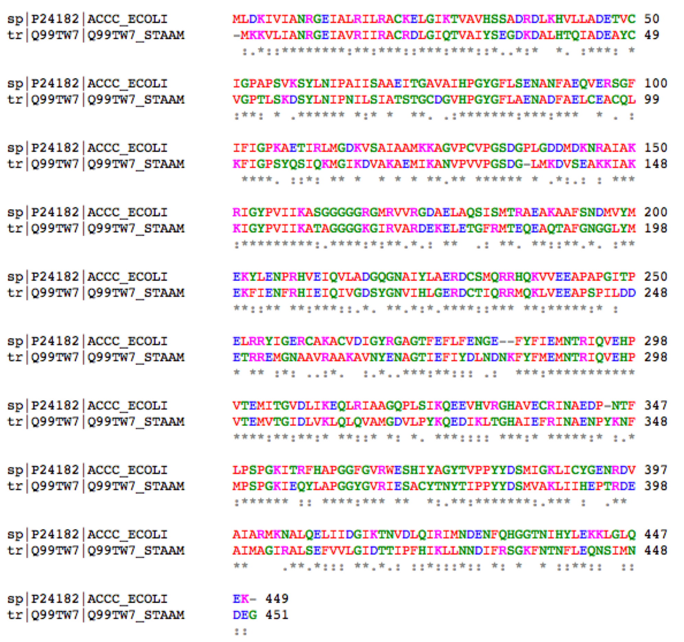
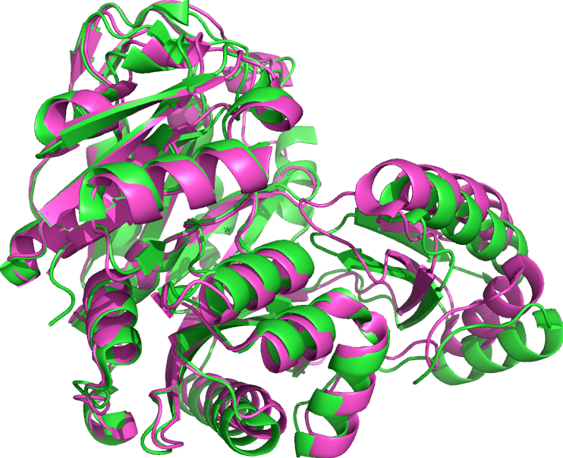
It turns out the structure is already available, and almost identical despite sequence differences
Notes:
Note that they use a different frame of reference though so you have to align before similarity is obvious

Slide 39
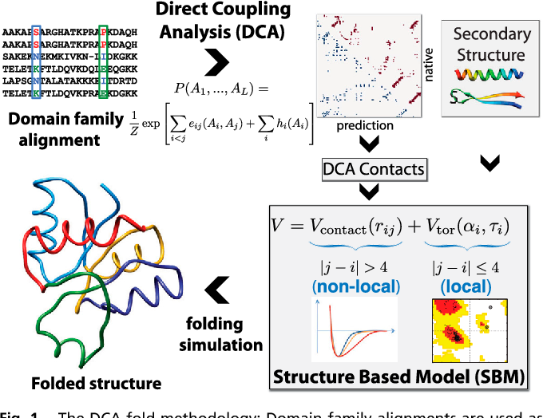
Leveraging evolution to learn protein structures
(1) Sulkowska et al. “Genomics-aided structure prediction” DOI:10.1073/pnas.1207864109

Slide 40
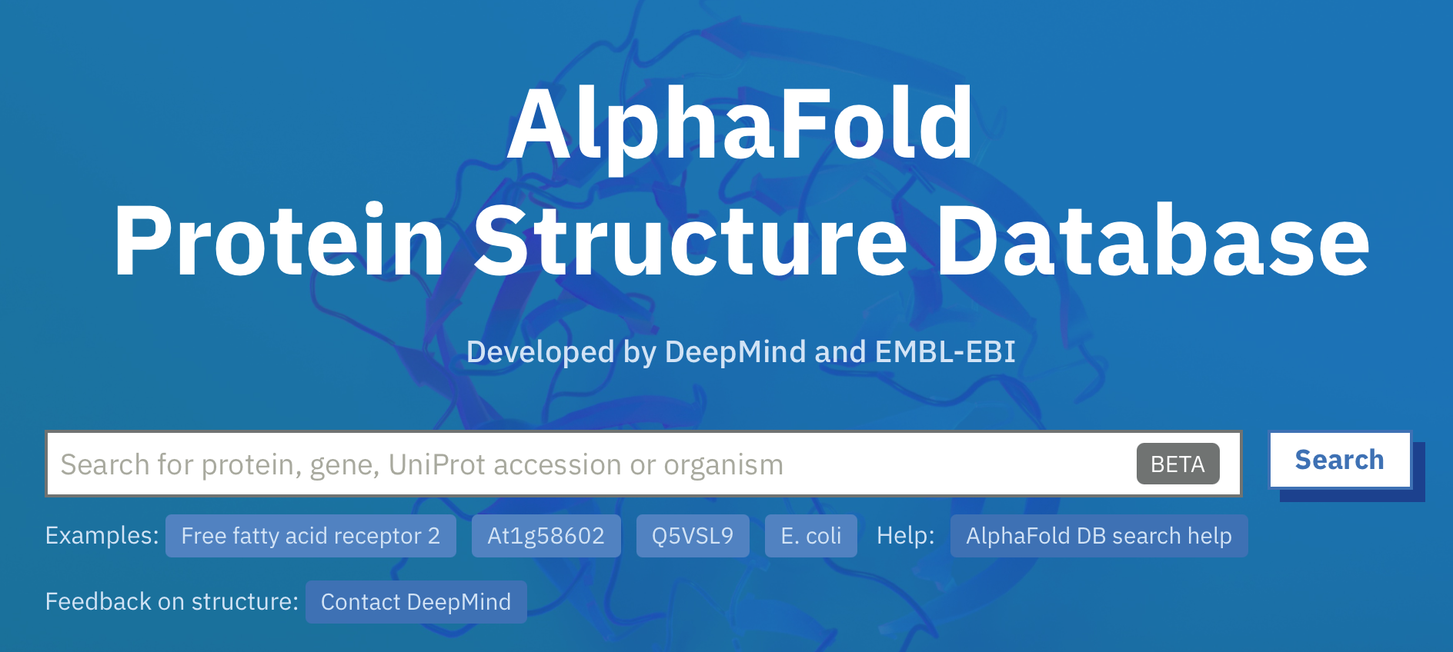
AlphaFold: The future for protein folding? Sometimes
AlphaFold is an AI system developed by DeepMind that predicts a protein’s 3D structure from its amino acid sequence. It regularly achieves accuracy competitive with experiment.
Do not use the resource blindly. Apply towards research projects when you have a strong foundation of what a reasonable result should be. Remember: you must justify your choices in review!
(1) https://alphafold.ebi.ac.uk/search/uniprotDescription/Free%20fatty%20acid%20receptor%202

Slide 41
Outline
Background: why the starting configuration can make or break your simulation
Theoretical considerations: statistical mechanics, protein physics
Limitations of atomic resolution simulations
Structure files
Protein Data Bank: crystallography, NMR, cryo-EM, alphaFold
Tools and considerations

Slide 42
AlphaFold: The future for protein folding? Sometimes
(1) Go to link
(2) Search “free fatty acid receptor 2”
Q: How would you assess which parts of this model are most trustworthy?
(1) https://alphafold.ebi.ac.uk/search/uniprotDescription/Free%20fatty%20acid%20receptor%202

Slide 43
AlphaFold: The future for protein folding? Sometimes
(1) Go to link
(2) Search “Histone domain containing protein, uniprot: A0A077ZLJ1”
Qs: (1) What part of the protein did AlphaFold struggle in prediction? (2) Is this a bug or a feature? (3) Can it be improved?
(1) https://alphafold.ebi.ac.uk/search/uniprotDescription/Free%20fatty%20acid%20receptor%202

Slide 44
This motivates homology or comparative modeling: Often, proteins have high structural similarity even at low sequence identity
Globular, homologous proteins have sequence similarity:
Above 50% sequence identity, models are generally quite good, with errors mostly in sidechain positioning
In 30-50% range, errors can be more severe, but often still tolerable (generally considered acceptable)
Below 30%, all bets are off
Sequence identity: Fraction of amino acids that are exactly the same
Sequence similarity: Fraction that have similar properties (i.e. polar, positively charge, negatively charged, hydrophobic)

Slide 45
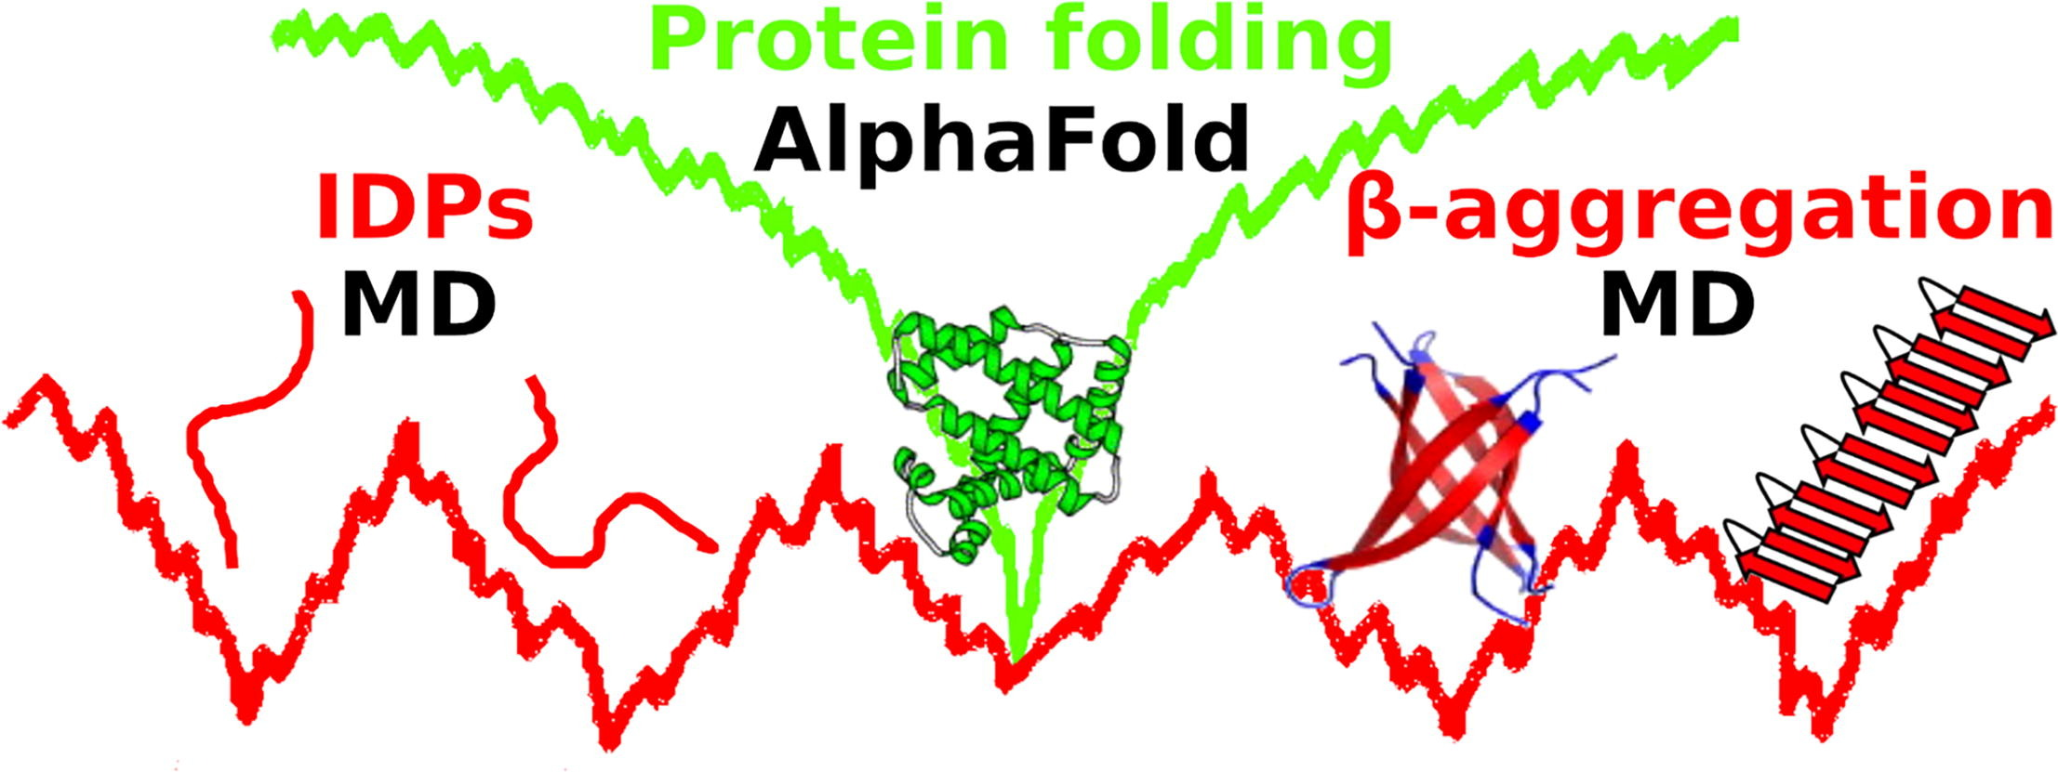
Sequence identity and sequence similarity are related but different concepts
But Intrinsically Disordered Proteins (IDPs) and Intrinsically Disordered Regions (IDRs: loops, tails) evolve faster.
There is less constraint on their evolution so there is less signal in their homology data
AND their free energy landscapes are broad and shallow.
(1) Birgit Strodel, “Energy Landscapes … Disordered Proteins” https://doi.org/10.1016/j.jmb.2021.167182

Slide 46
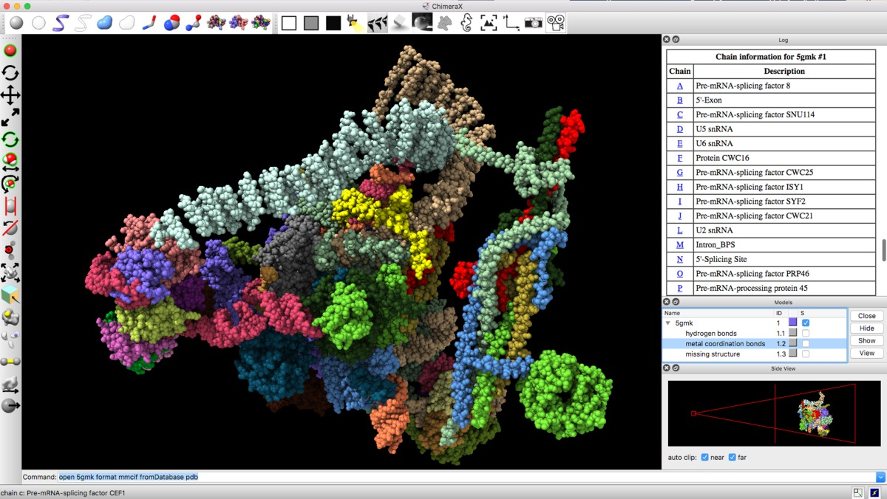
AlphaFold, docking, visualization tool: UCSF ChimeraX
Uses MODELLER: you can edit structures for simulation with GUI visualization.
It can search for solved AlphaFold structures, or you can run yourself:
https://www.rbvi.ucsf.edu/chimerax/data/alphafold-nov2021/af_sbgrid.html
Tools for docking and ligand visualization:
https://www.youtube.com/watch?v=iZPDRLH9W2U

Slide 47
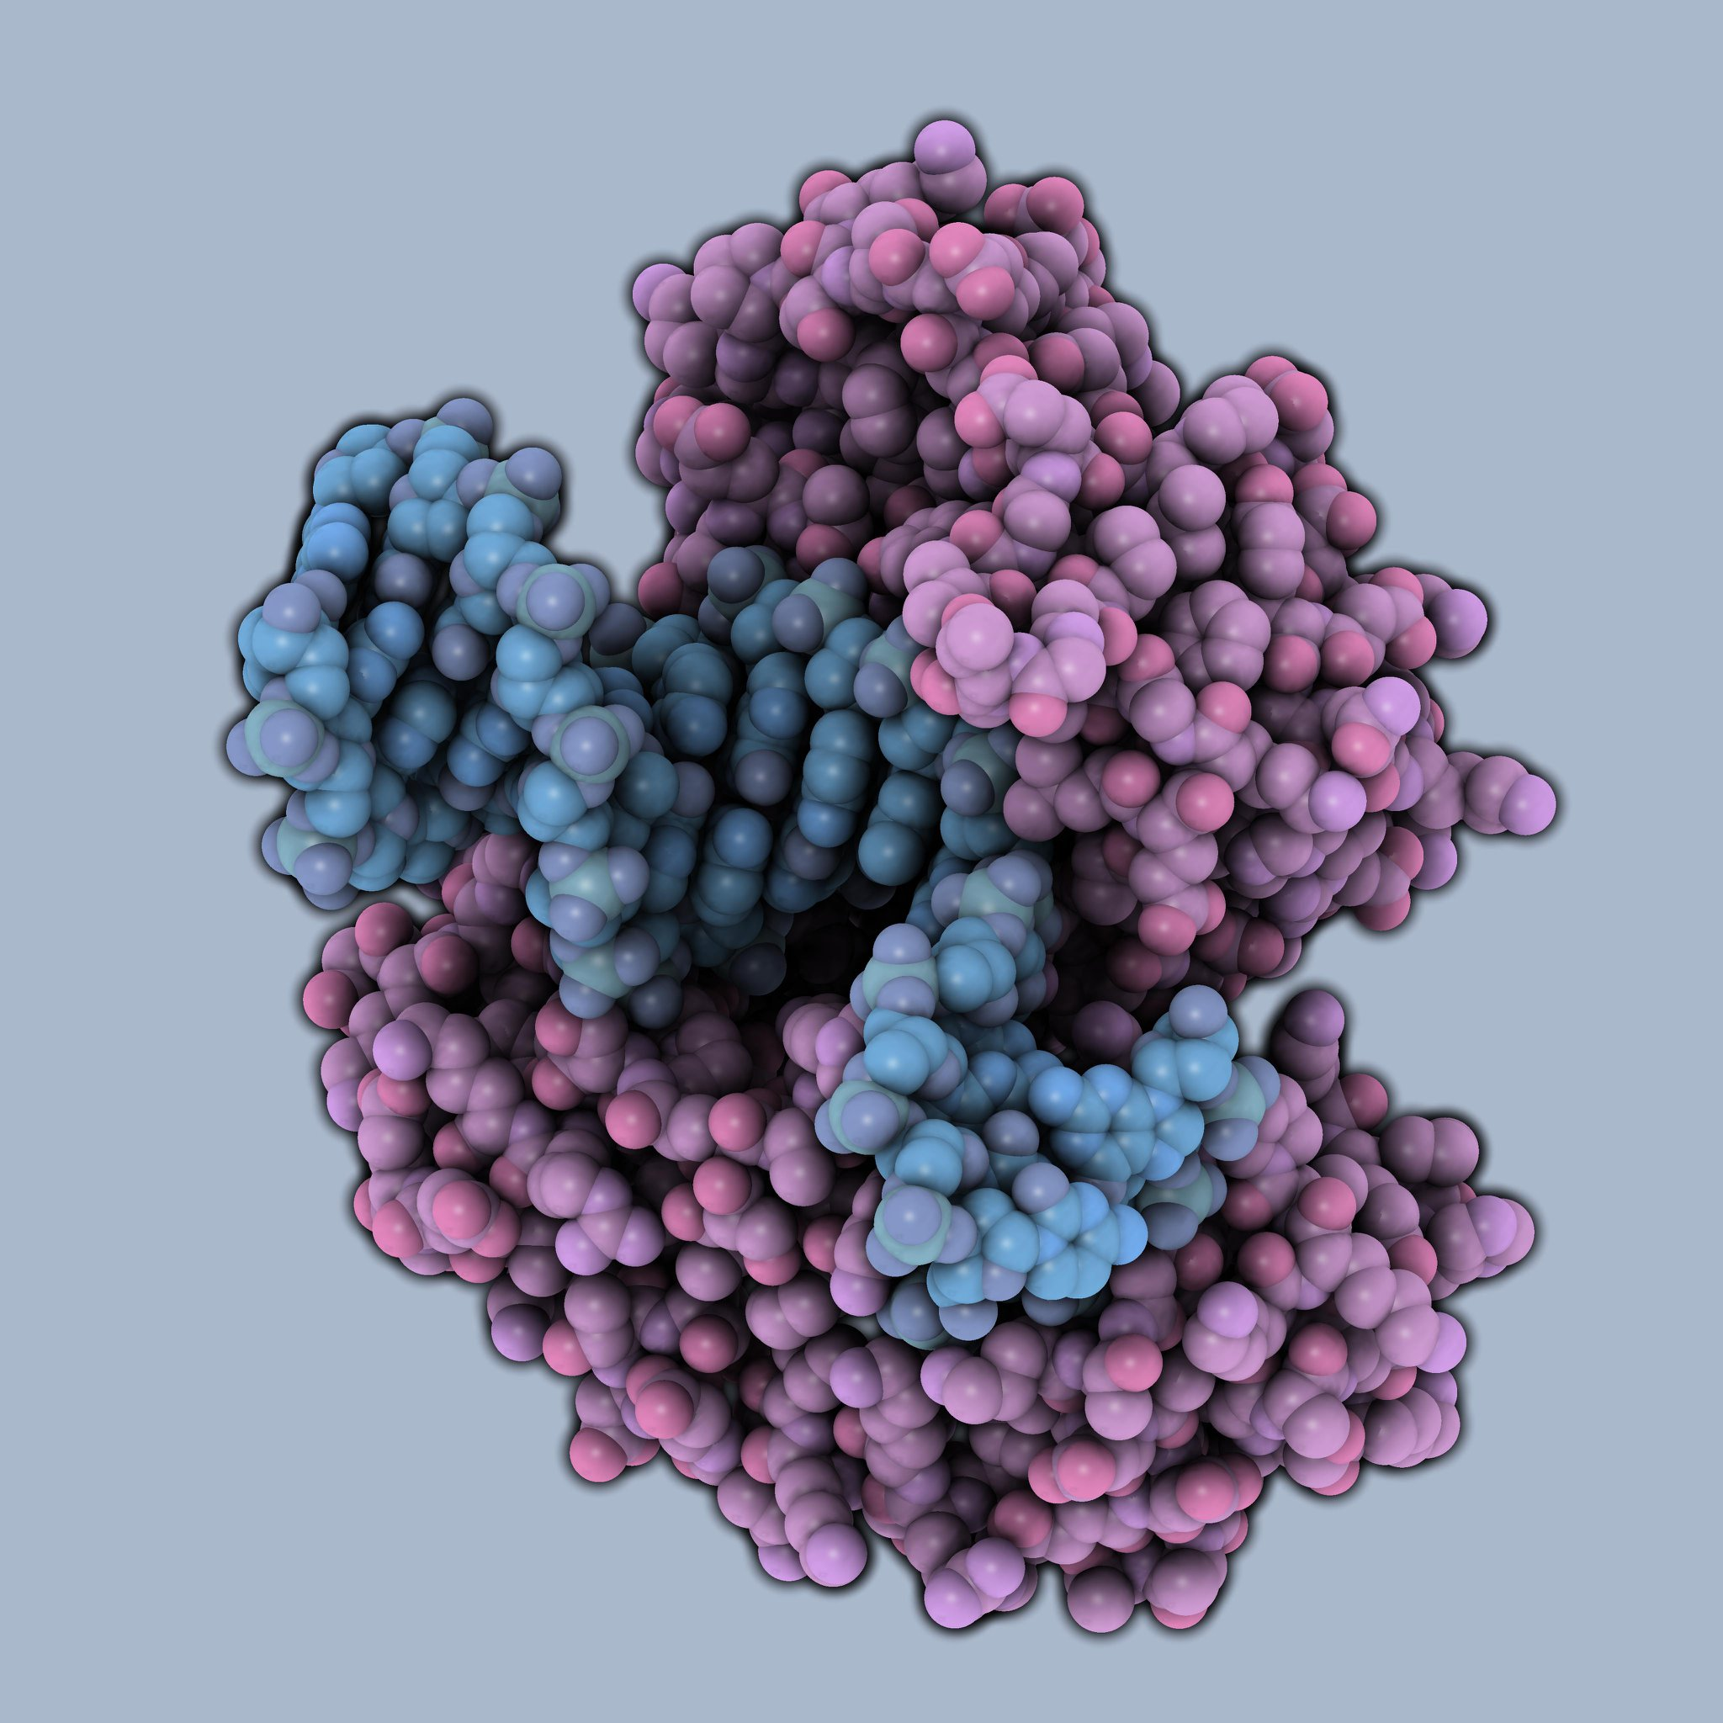
In a limited pool of GUIs, which should you use?
Visualization:
QuteMol: Impressive images, zero effort.
Pymol: great for a lot of things, sometimes lacking for MD. Python interface, most people start here.
Chimera: high degree of customization, some learning curve. But, added features that are hard to replace in a GUI.
VMD: Useful for trajectories, but unpolished publication quality images. Scripting for Tk console can be tedious.
difficulty
QuteMol image: attribution unknown
(1) Wiki: https://en.wikipedia.org/wiki/QuteMol

Slide 48
Pause before you proceed, what to do before MD
Checklist, open your structure files and preferred GUI:
Is the structure I got the right one?? Is it the correct species? No substitutions? Highest resolution?
Are loops or bonds unphysically crossing each other?
Are there large clashes detected? (VMD, or Chimera ‘find clashes’ command (https://www.cgl.ucsf.edu/chimera/docs/ContributedSoftware/findclash/findclash.html)
Are there heavy or exotic residues left as an artifact of experimental resolution?
Are any atoms missing?
Are protonation states defined? Calculated? If not, why not? To calculate: H++ Server.
Should any heavy atoms, such as metals, be included in specific locations?
Remember: any and every decision you make at the start in MD can be questioned in review.
Keep notes of what you did and why you did it. Reproducibility matters.

Slide 49
Prepping structures the automated way
Checklist, open your structure files and preferred GUI:
Orion
OESpruce, OEBio (https://docs.eyesopen.com/toolkits/python/oechemtk/index.html#oebio-theory)
scripting with MODELLER
Scripting with tleap and PARMED.
These tools are good once you have a dedicated workflow. But, don’t just hit play on a downloaded script.
Remember: any and every decision you make at the start in MD can be questioned in review.
Keep notes of what you did and why you did it. Reproducibility matters.

